Slide 1
Start script detect_lego_markers_simple_rp.m.
This script identifies markers for objects of known dimensions (Lego). As calibration objects we used 4 Lego® plates. Each plate is seen by 4 cameras. Thus the script needs to be run 16 times (4 plate for each of the 4 cameras). Each time a data file is saved (e.g. camera1_lego_h0_data_rp.mat for plate 0 from camera 1).
Once all plates and cameras are saved you can use calibrate_cameras_rp.m to estimate the camera matrices.

Slide 2
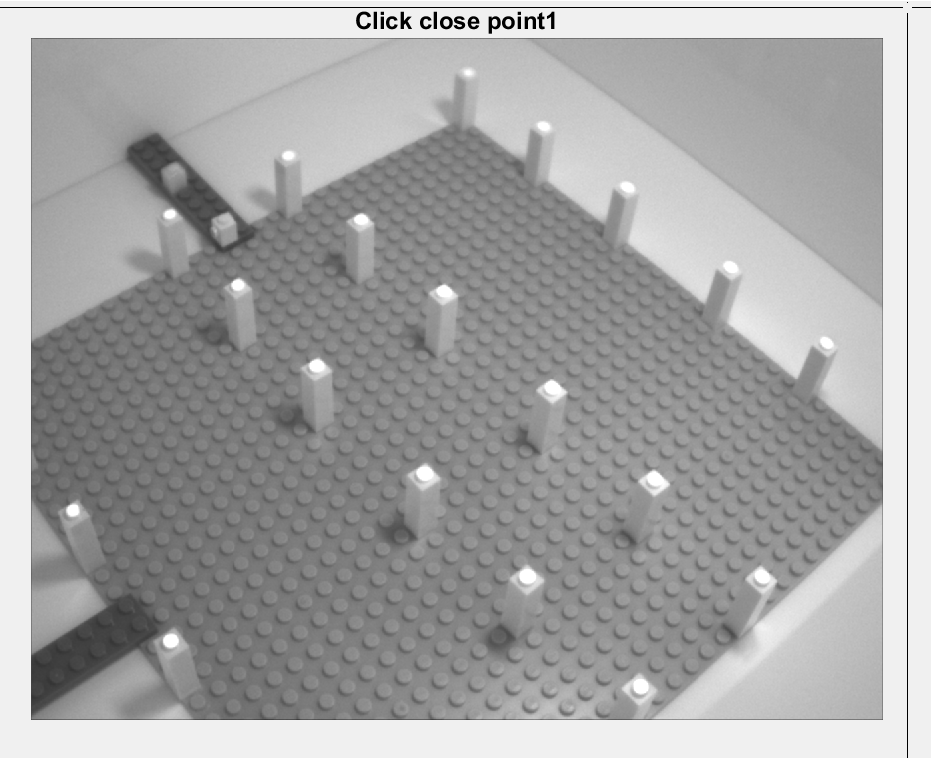
Start script detect_lego_markers_simple_rp.m. You should see this screen:
Click on each marker to store its position in the image.
Use ONLY the 8 markers at the centre of the plate.

Slide 3
Once you clicked on all 8 internal markers you should see this kind of image.
Check the numbers for each marker. IMPORTANT: remember to always mark in the same order across different cameras (1 to 8). Use the black pieces on the side of the plate as reference.

